Slide 1
Topic: Time zones
EQ: How do we solve problems involving time zones in Australia?

Slide 2
Learning objectives
Solve problems involving time zones in Australia and around the world, making necessary allowances for daylight saving (ACMEM163)
Solve problems relating to travelling east and west, incorporating time zone changes (ACMEM166)

Slide 3
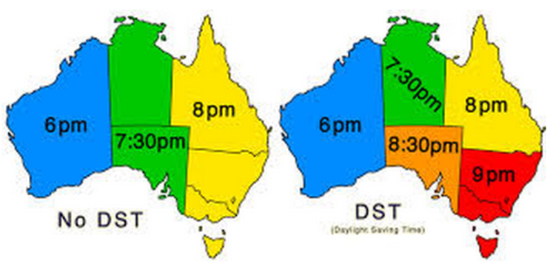

Slide 4
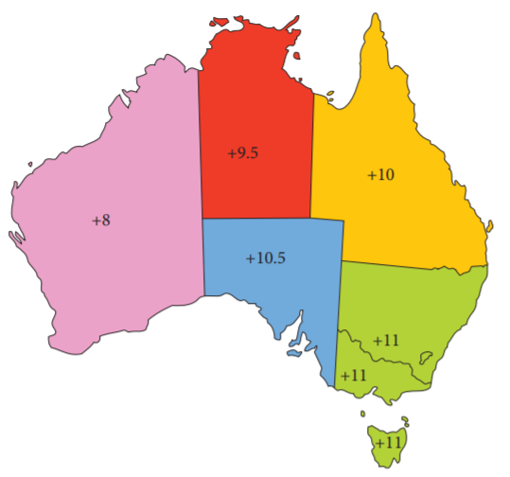
24
7
30
Topic: Time zones
Date
EQ: How do we solve problems involving time zones in Australia?

Slide 5
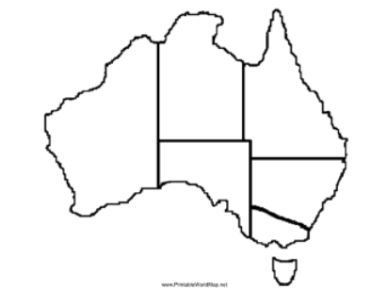
24
7
30
Topic: Time zones
Date
EQ: How do we solve problems involving time zones in Australia?

Slide 6
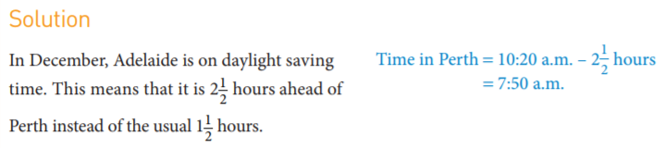
24
7
30
Topic: Time zones
Date
EQ: How do we solve problems involving time zones in Australia?
Example 1:

Slide 7
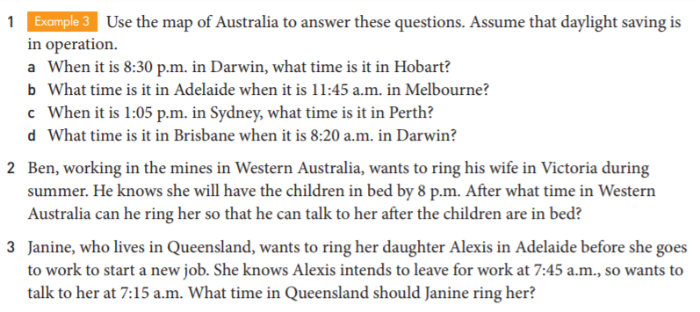

Slide 9
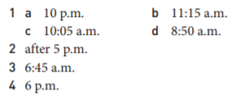

Slide 10
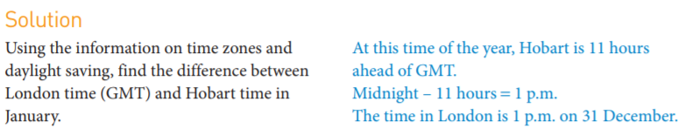
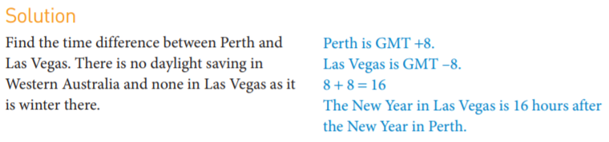
Time zone Practice
Example 1
Example 2

Slide 11
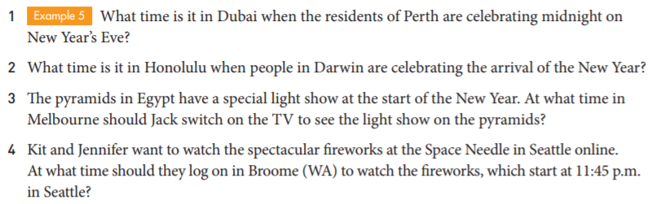
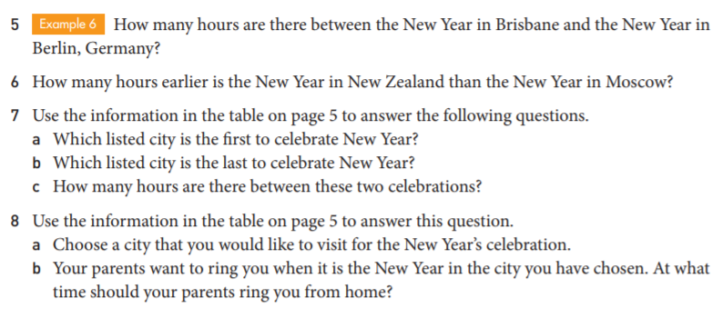

Slide 13
